Slide 1

MeteoCal
Project development for the 2014 Software Engineering 2 Course
Authors:
Andrea Bignoli
Leonardo Cella
Department of
Computer Science And Engineering
Supervisor:
Prof. Elisabetta Di Nitto

Slide 2
Preliminary Notes
In our presentation we will reference other documents produced during the development of the project. Everything that we are going to reference, including the source code, can be found at:
https://code.google.com/p/meteocal-bignoli-cella/

Slide 3
Requirement analysis and specification

Slide 4
Problem Description
The first step in the development of this project was an accurate and precise analysis of the initial requirements. This allowed us not only to formalize the initial description of the problem, but also to solve any ambiguity due to the natural language formulation.
“The X company wants to offer a new weather based online calendar for helping people scheduling their personal events avoiding bad weather conditions in case of outdoor activities. Users, once registered, should be able to create, delete and update events. An event should contain information about when and where the event will take place, whether the event will be indoor or outdoor. During event creation, any number of registered users can be invited. Only the organizer will be able to update or delete the event. Invited users can only accept or decline the invitation. Whenever an event is saved, the system should enrich the event with weather forecast information (if available). Moreover, it should notify all event participants one day before the event in case of bad weather conditions for outdoor events. Notifications are received by the users when they log into the system.”

Slide 5
Ambiguity Resolution
In our initial analysis we decided to solve any ambiguity by providing the most complete and flexible functionality we considered useful in a real world environment.
For instance we decided to allow the creation of events of any duration, without fixing an upper bond in this phase of the project, since we considered this an unnecessary limit for the usage of our application. Our service will provide a series of weather forecasts covering the whole duration of each event. Obviously the weather forecasts checks regarding adverse conditions will consider the whole duration of the event.
We also assumed that events of a user may overlap, since this was the possibility that granted more flexibility of operation to end user.

Slide 6
Ambiguity Resolution
An other important decision that we made is that the creator of an event should be allowed to choose, for each event which weather conditions should be considered adverse.
Even if this is not mentioned in the initial problem description, we considered this functionality as really important in a real world application.
The system will then produce notifications about weather forecasts depending on the set of adverse weather conditions defined by the creator of the event.

Slide 7
Functional Requirements
With the previous considerations we formulated the following functionalities to provide, devided by actor involved:
Guest
Sign up
User
Login
Account Management (view settings, edid settings, calendar privacy...)
Calendar Management (view, reach event, manage...)
Event Creation
Event Management (view, participate, cancel participation...)
Invitation Management (view, reach related event, reply...)
Notification Management (view, reach related event...)
Search for events and users on the system
View event and user pages according to visibility rules

Slide 8
Functional Requirements
Event creator (on the created event)
Invite users
Edit event details, scheduling
Cancel event
Receive a suggested reschedule change in case of bad weather conditions
The system will provide and update weather forecasts for all the planned events whenever available and automatically notify the creator in case a better scheduling for an event is found. The notifications are generated according to the problem description.
The description presented here provides a basic overview of the functionalities our system offers. More details can be found in the Requirement Analysis and Specification Document.

Slide 9
Non – Functional Requirements
User visible aspects of the system, not directly related to the functional behaviour.
User Interface: a practical and intuitive website;
Client:
Errors Handling: all the errors observed in the testing phase were conveniently managed;
Documentation: RASD, DD, User Guide, Installation Guide.
To use our application is not required any specific knowledge, and is neither necessary an installation;

Slide 10
Architectural Considerations
The website is realized with the J2EE technology, it is sustained on a MySql database for the information management.
From the graphic point of view, we have used the components offered by the PrimeFaces library, these modules are then arranged with style sheets in order to get a more accurate arrangement.
In closing in the matter of the weather forecasts service, we rely upon an OpenWeatherMap.

Slide 11
Model Coherency – Alloy Analysis
We made use of Alloy to verify the coherency of the model we formulated to answer the requirements we stated. The analysis is the most accurate possible in the representation of our system.
In particular, all the main relationship regarding users, events, notifications, invitations and weather forecasts have been considered and included in the model.

Slide 12
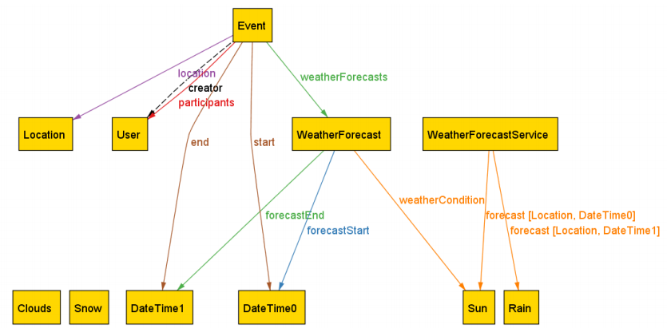
Model Representation – Alloy Analysis
The alloy analysis also allowed us to produce diagrams showing different relationship between the elements of our application.
The forecast sequence associated to an event covers its duration.
The forecasts provided are the ones produced by the external weather forecast service for the given location and time (associated to weather conditions not represented here for clarity).

Slide 13
Use Case Analysis
A detailed version of the use cases is reachable in the RASD, here we want to take just a glance focusing on the main aspects.
We start by showing an overview diagram. Then we’ll show an example of this analysis.

Slide 14
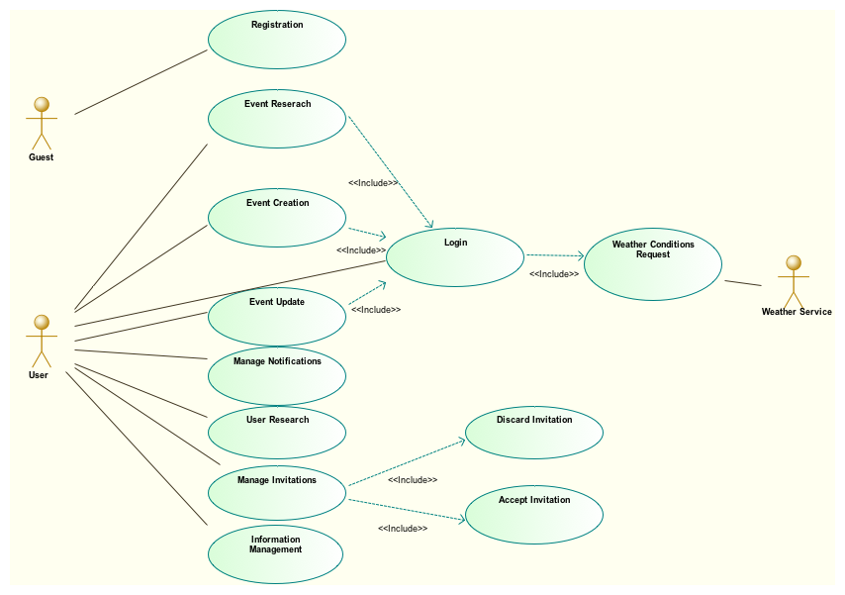
Use Case Analysis – Overview Diagram

Slide 15
Use Case Analysis – Event Creation
Actor: User;
Input conditions: The User is already logged in the system;
Output conditions: His calendar contains the just created event;
Events flow:
The User starts to create a new event thanks to the topbar;
The system provides a new form, and the User has to fill the fields with the information about the new event;
Once the User confirms the operation, the system does the required checks and operations for the event;
If so the User is brought to the created event page, otherwise if occurs any error the User can repeat this operation.

Slide 16
Design

Slide 17
Persistent Data Management
Our application will make use of a relational database for persistent data management. So, starting from the specifications described in the previous section, we started designing it by following the process reported in the following slides.

Slide 18
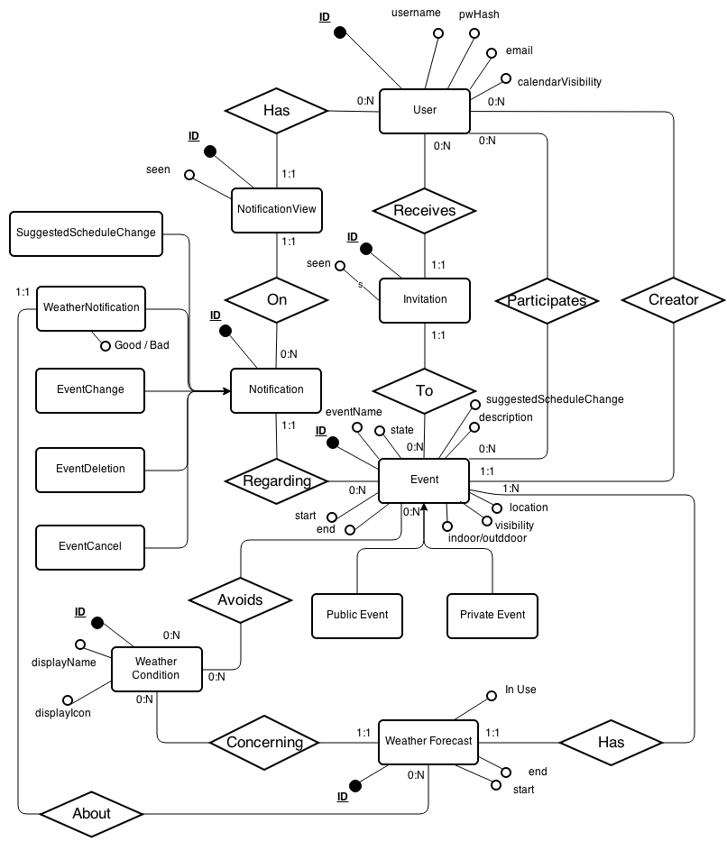
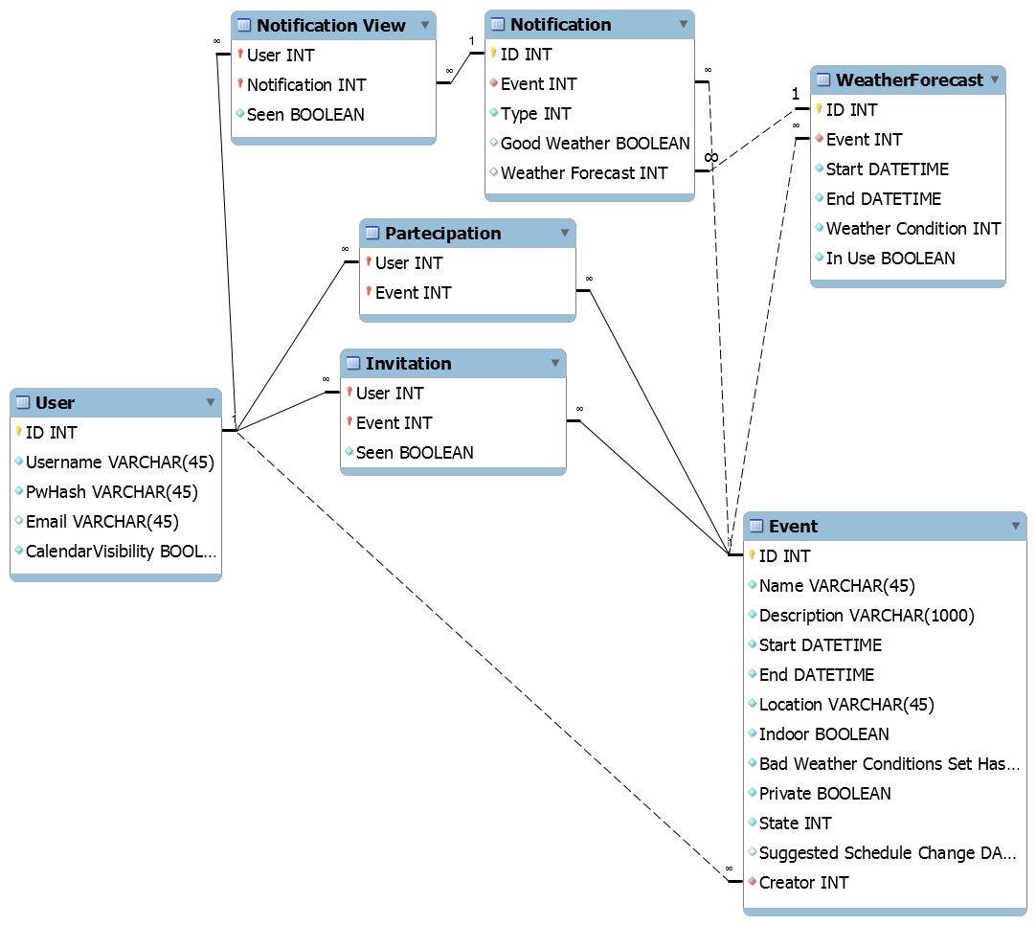
Persistent Data Management –Design
Production of an ER diagram and translation into a Logical description for the database:

Slide 19
Persistent Data Management – Logical Design
In our implementation, the database structure is actually created using JPA. This allowed us to benefit of all the tools the API offer, while also define some flexible behaviours for field conversions between Java objects and database entries.

Slide 20
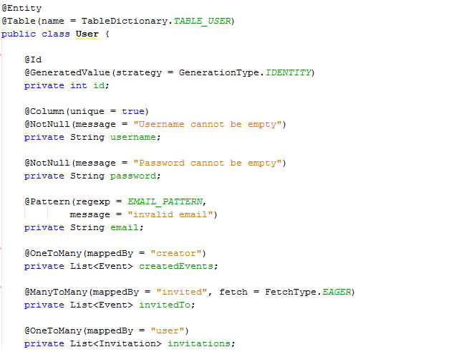
Persistent Data Management – Logical Design
An extract of the User table definition:

Slide 21
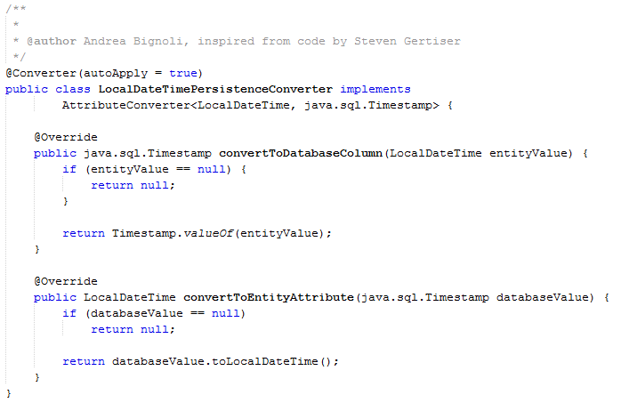
Persistent Data Management – Logical Design
JPA allows the creation of custom converters. For example, the following converter is used to efficiently convert the set of adverse conditions chosen for each event into an integer hash (representing the bitmask of the set).

Slide 22
User Experience – Introduction
In this section we are going to describe the user interface level of our application, we will focus the attention in the main aspects.
For each diagram we will show the relation that holds among:
The User Experience diagrams,
The real pages, with the some code particularly relevant.

Slide 23
User Experience
Correspondence between the diagram and pages.
To manage resource access we make use of filters:

Slide 24
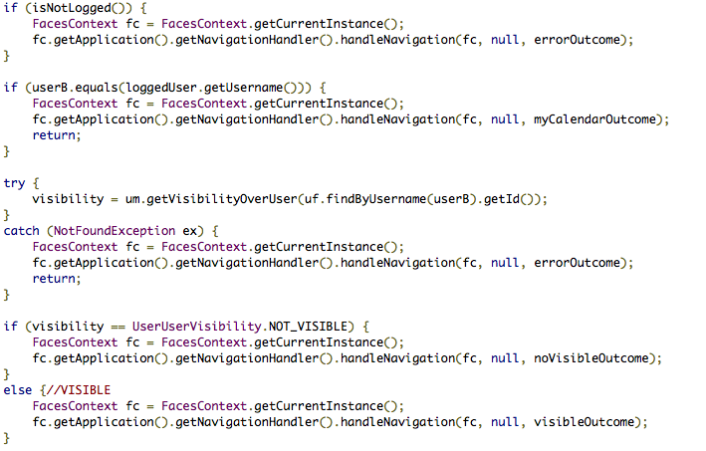
User Experience – Other User Calendar

Slide 25
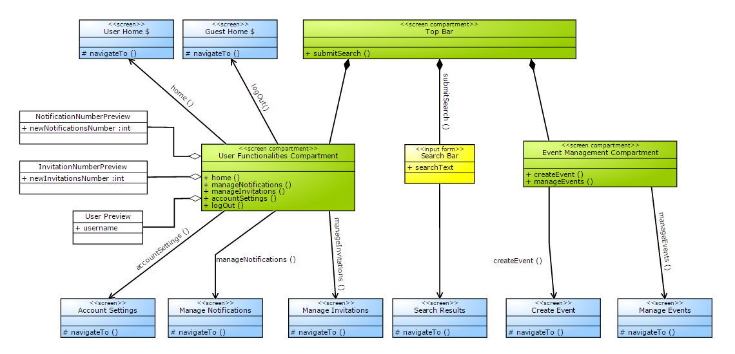
User Experience – Topbar
The Top Bar included in every user page of our platform:

Slide 26
User Experience
Correspondence between the diagram and the page.
This is the component that will be included in each page of the User Subsystem. As we have already said, it contains all the functionalities offered by the systems, it is like a bridge from the current page to the desired one.
It doesn’t contain only links to other pages, but also a search textarea that allows the research of user and events.
This is realized following the definition of component, in fact we have only one page that defines this module, all the other includes this one.

Slide 27
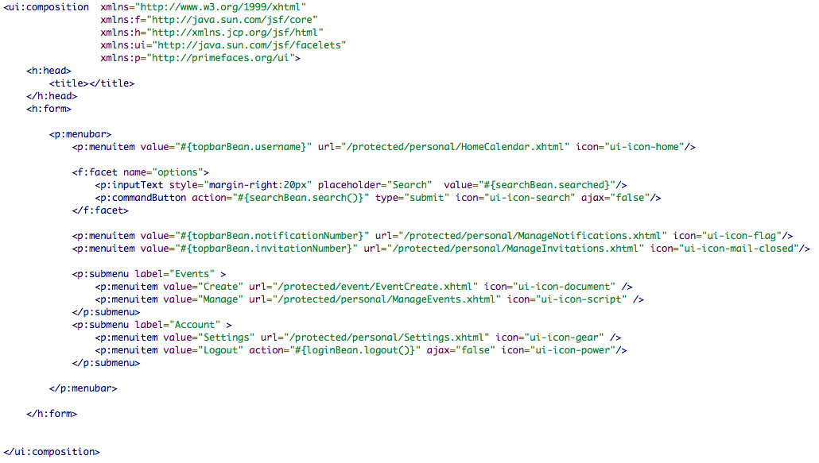
User Experience – Code

Slide 28
User Experience
In summary the events subsystem within the User domain is mapped with the following pages:
EventPage
EventPage As Creator
EventPage As Viewer
EventPage No Visibility
As was mentioned before, each page contains its filter except for the one that represents the case in which the user hasn’t visibility over an event, to allow perfectly safe resource management.

Slide 29
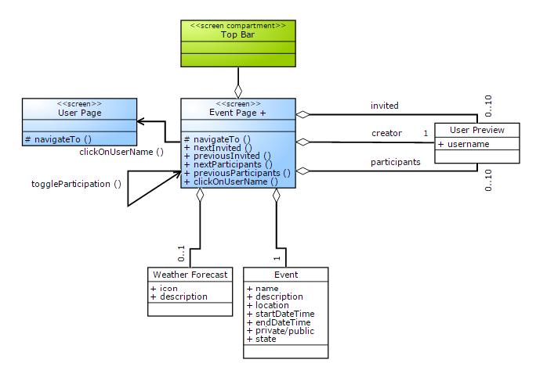
User Experience – User Visibility

Slide 30
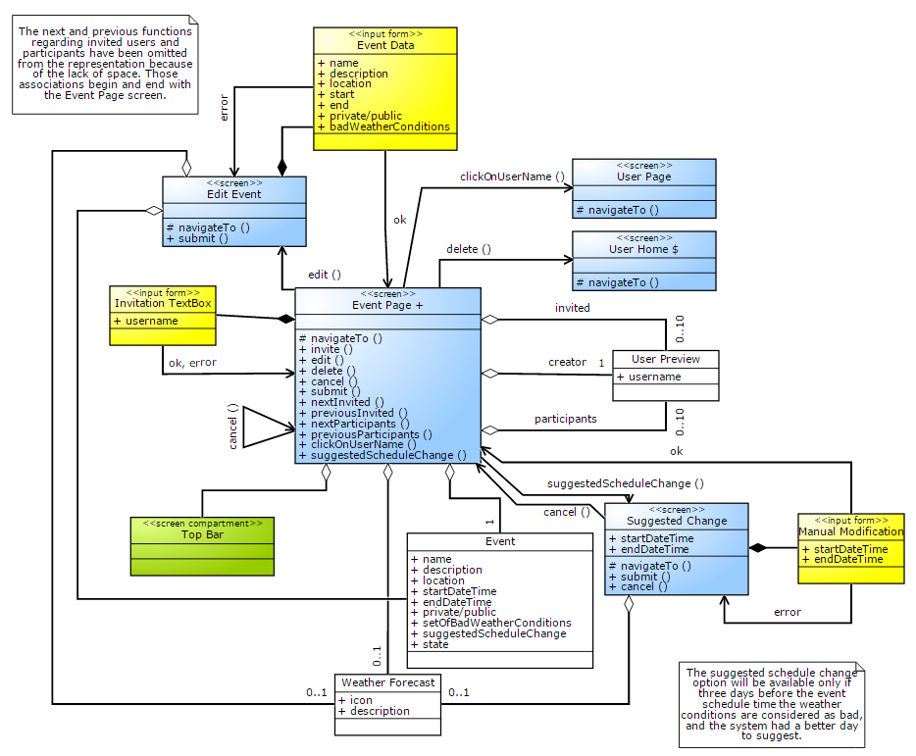
User Experience – Creator Visibility

Slide 31
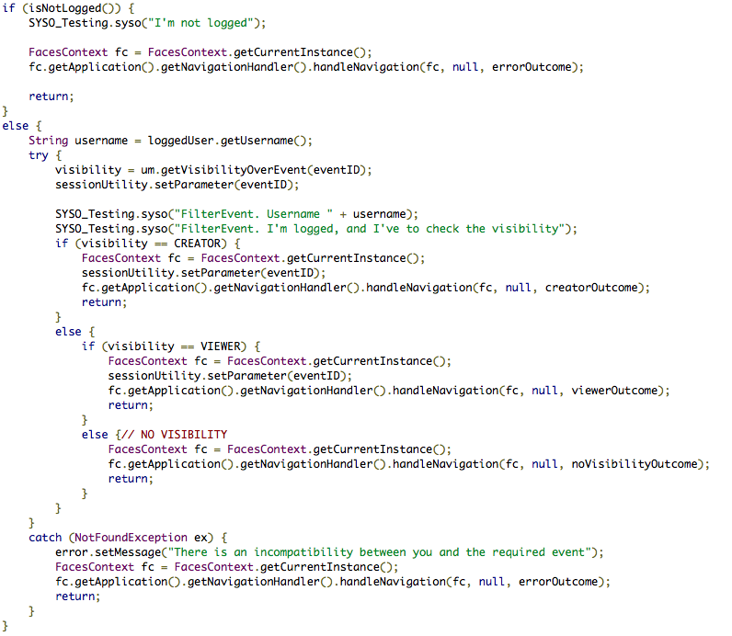
User Experience – Filter’s code

Slide 32
BCE – Introduction
Now we have decided to move back to the design representation, in particular here we will illustrate the BCE diagrams.
Here we present the relationship between:
Controls and Beans
Boundaries and Web pages

Slide 33
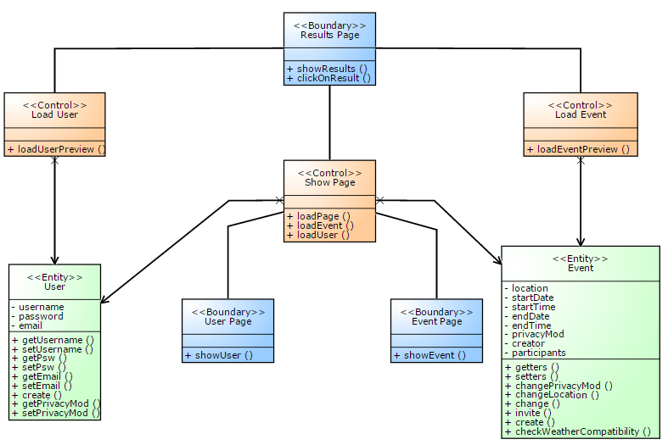
BCE – Search Bar

Slide 34
BCE – Search Bar
This module was touched on before just one time, but it is interesting. Its purpose consists of making a list of results splitted in events and users, according to the word that the connected user is looking for.
The association betwen the diagram and the real system is shown in the next slide.

Slide 35
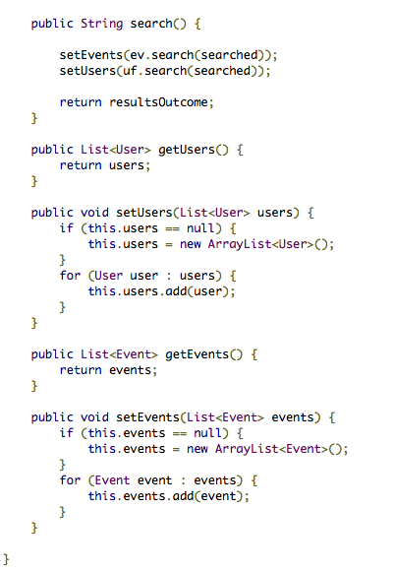
BCE – Search Bar Mapping
This is the source code of the SearchBean.
We point out the following functions:
search( ) : it loads the two sets of elements according to the searched word.
set/set user( )
get/set event( )
They translate the respectively functionalities:
loadPage
loadEvent
loadUser

Slide 36
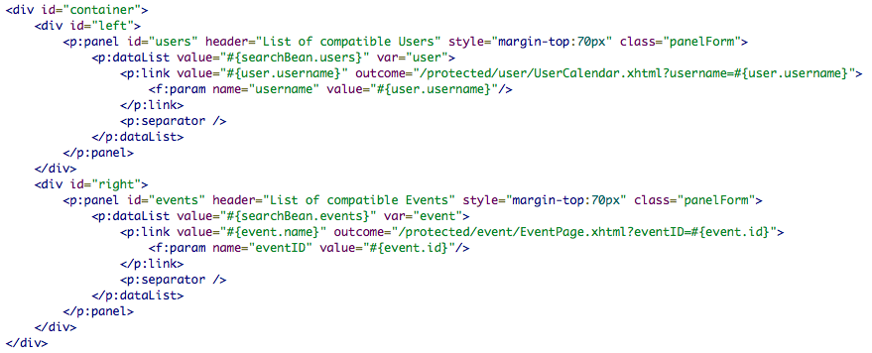
BCE – Search Bar Mapping
This is the xhtml page that actualize the ResultsPage, in fact it has also the same name.
From this page is possible to move to:
The Event Page;
The User Page.

Slide 37
Code Structure and Highlights

Slide 38
Data Access Object Pattern
To make full use of the tools that JPA offer to developers, we decided to integrate this pattern in our system. In particular this allow us to introduce a further level of abstraction in the access to the data contained in the database.
To actually implement this we created a basic DAO including operations common to each entity we manage (e.g. Find by primary key). On top of this we created individual DAOs for each entity (thanks to class inheritance) to define functionalities related only to the entity that specific DAO refers to.

Slide 39
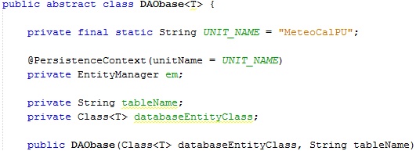
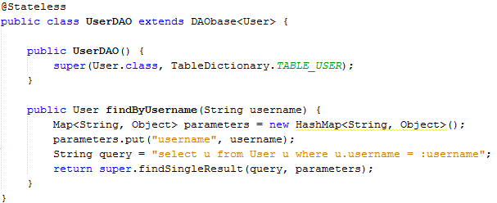
Data Access Object Pattern
First lines of the basic Data Access Object.
Specialization into User DAO by inheritance.

Slide 40
Interface Layers
To grant maximum maintainability and flexibility to our application, all the dependencies between the business tier and other components make use of interfaces.
For instance, every request coming from the Web Tier is actually directed to an interface defined for the facade that offers that service.
This weakens the component dependency constraints allowing greatly improved maintainability.

Slide 41
Geographic Structure
During event creation the user can choose the location by selecting country and city from a list offered by the system.
The initial data can be found at this address:
http://www.unece.org/cefact/codesfortrade/codes_index.html
This data was converted in JSON format to be quickly loaded at startup by our application. The convertion was made using a Python script reported on the following slide.

Slide 42
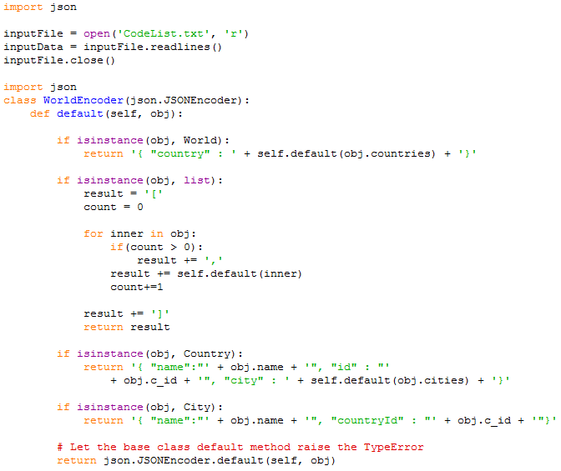
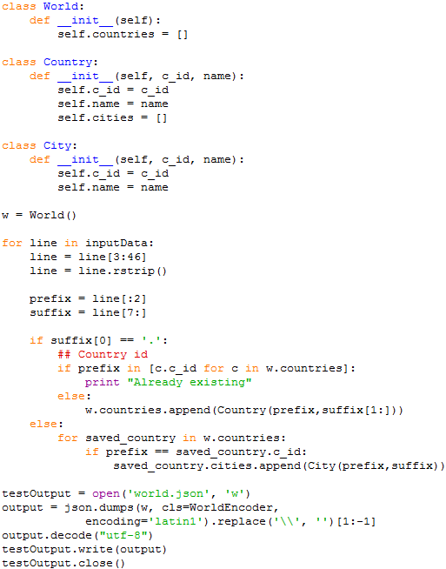
Geographic Structure

Slide 43
External Weather Service Interface
The application make use of OpenWeatherMap. The service offers forecasts:
For the next 5 days with a 3 hours precision
For the next 16 days with a daily precision
Even though the first would be enough to provide a service that perfectly respects the requirements, combining the information of the two forecasts clearly allows a better result.
We decided to follow this approach then, even if this increased the work in development.

Slide 44
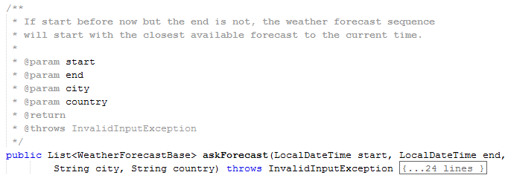
External Weather Service Interface
Our interface offers different functionalities to the rest of the application. The main ones are:
That returns a list of weather forecasts for the given location, covering the time interval delimited by start and end.

Slide 45
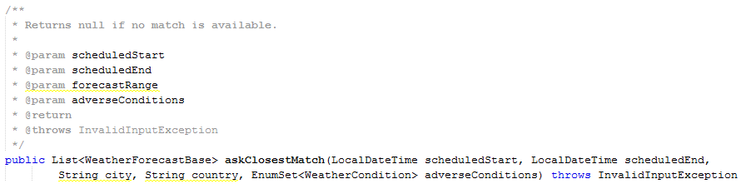
External Weather Service Interface
And:
That given location and current scheduling for an event, returns the closest time frame of the same duration with forecasts not in conflict with the specified weather conditions to avoid.
This is used to efficiently produce suggestions for schedule changes in case of bad weather conditions.

Slide 46
Automated Testing
Due to the strict time constraints the automated testing doesn’t cover the whole application. We obviously can state though that, by the manual testing performed over the system, no anomaly has been observed. This process was also the base of our Test Cases document.
We focused mainly on Integration Testing using Arquillian. This type of tests covers for example, the whole operational cycle of our interfaces to the external service. This certify not only that it works, but also that it is coherent with the JavaDoc promises.

Slide 47
Demo

Slide 48
Demo
The following videos, will show some of the basic operations that can be performed in the system.
Naturally, due to the limited time available, the demo won’t cover all the functionalities that our platform offers. Any of the following can be tested by using the material provided in our repository by installing our system as explained in the Installation Manual.

Slide 49
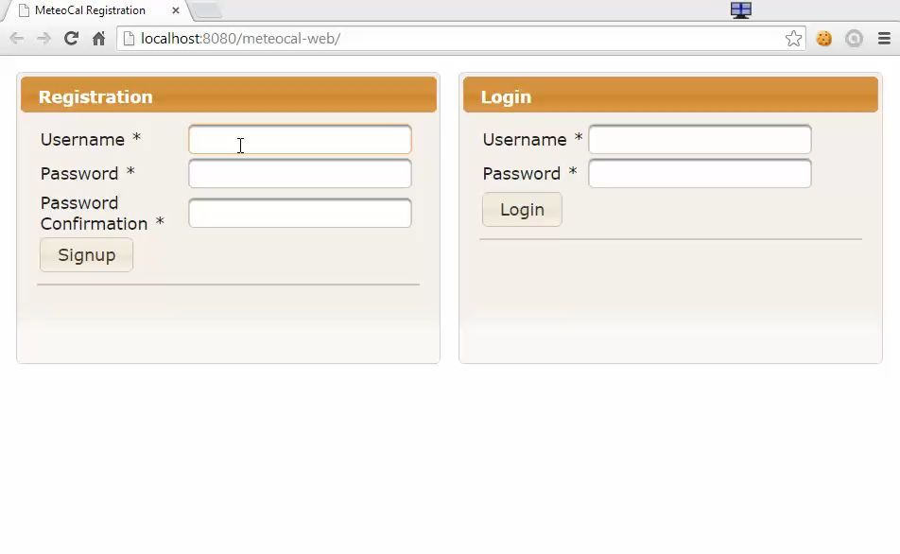
Demo - Registration

Slide 50
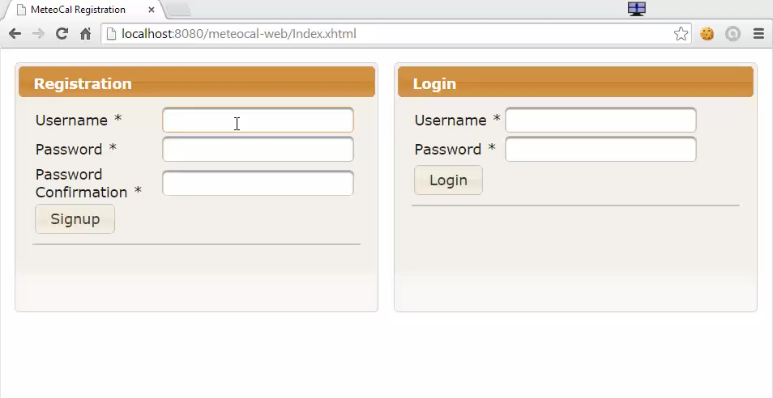
Demo – Registration with Error Handling

Slide 51
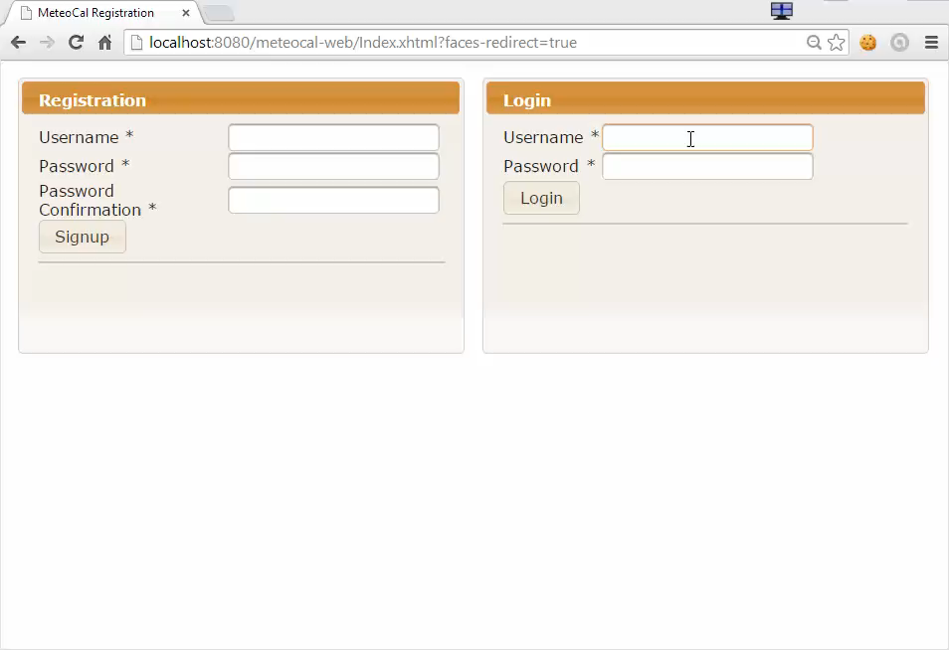
Demo - Login

Slide 52
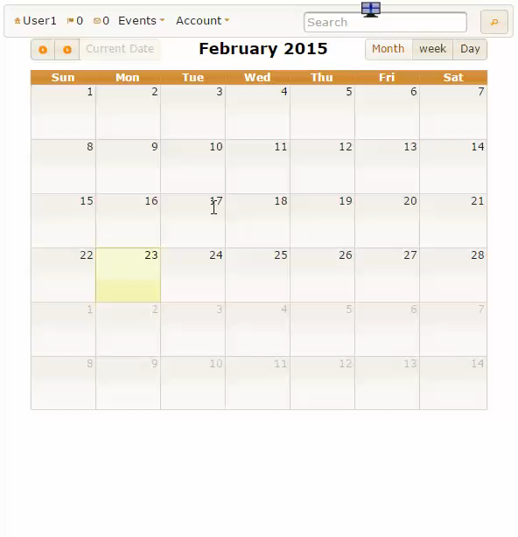
Demo – Create Event

Slide 53
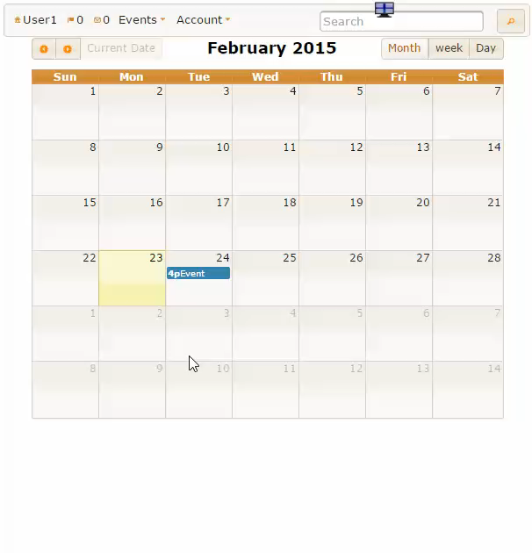
Demo – Invite More Users

Slide 54
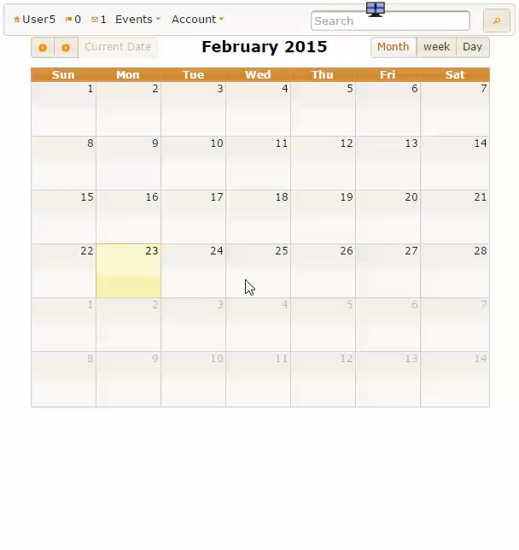
Demo – Decline an Invitation

Slide 55
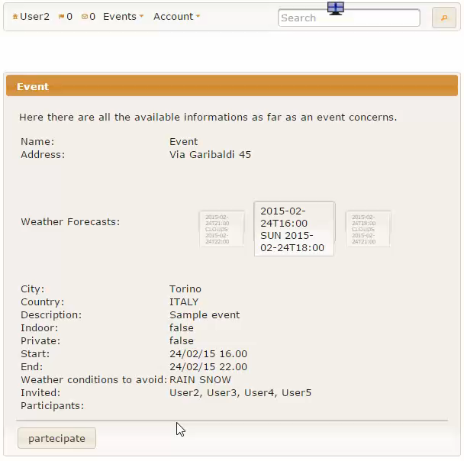
Demo – Join / Cancel Participation

Slide 56
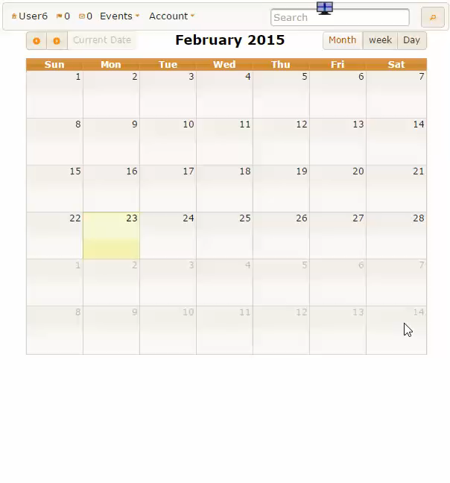
Demo – Search

Slide 57
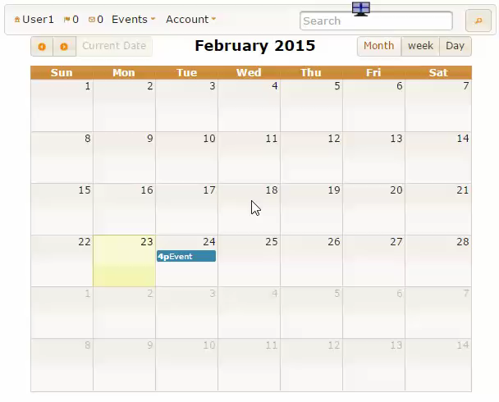
Demo – Edit Settings

Slide 58
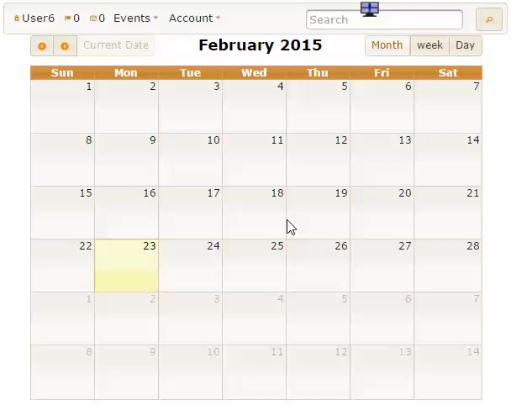
Demo – Public Calendar Visualization
One of the two events,
the second, is private, so no information is shown, other than the fact that User1 is busy in that time frame

Slide 59
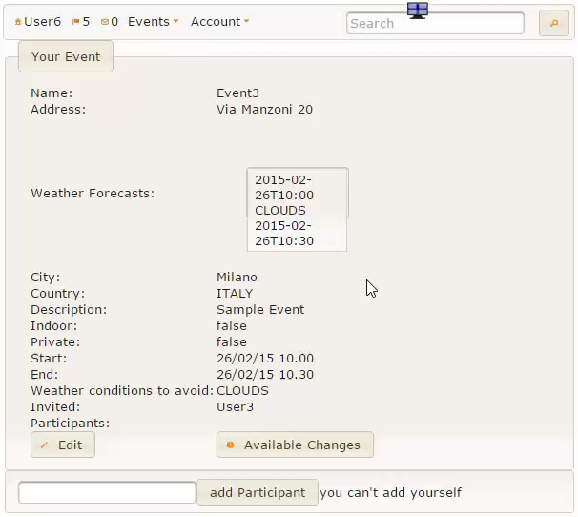
Demo – Suggested Re-Schedule

Slide 60
Project Report FP and COCOMO II

Slide 61
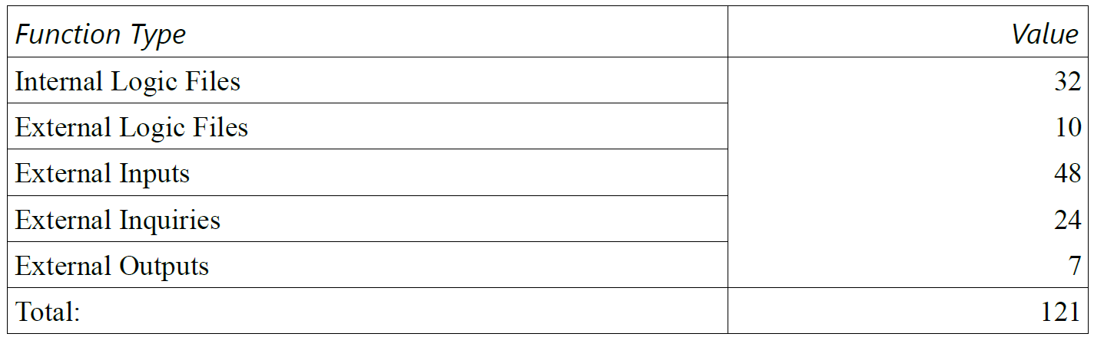
Project Report – FP
In summary:
With this estimation we get a LOC equal to:
121 * 46 = 5566
Our project is made of 7116 lines of code ( without considering empty lines, lines with only parenthesis or comments and css files).

Slide 62
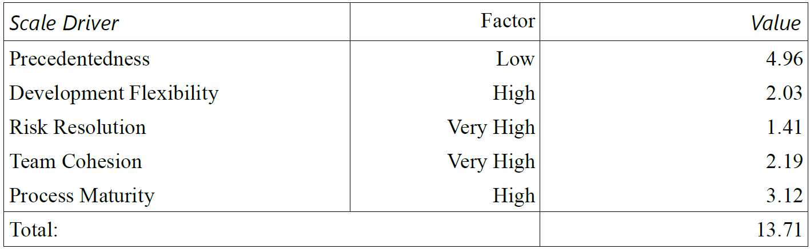
COCOMO II – Scale Drivers
These parameters were evaluated one per time, according to their
definition and not by taken the standard values.

Slide 63
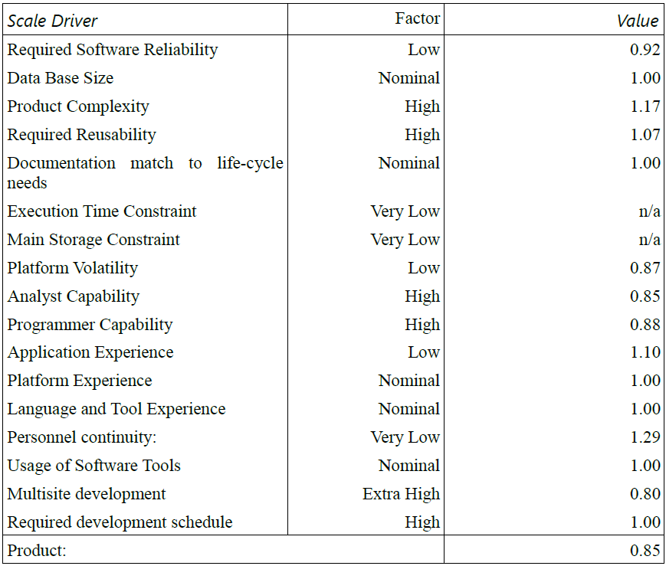
COCOMO II – Cost Drivers

Slide 64
COCOMO II – Effort Calculation
Using this formula:
Effort := A * EAF * KSLOC ^{E}
We obtained:
Effort := 2.94 * 0.85 * 5.566 ^{1.0471} = 15.0808 PM

Slide 65
COCOMO II – Duration Calculation
Using this formula:
Duration := 3.67 * Effort ^{F}
Where:
F := 0.28 + 0.2 * ( E – B ) = 0.3074
We obtained:
Duration := 3.67 * 15.0808 ^{0.3074} = 8.4 ≈ 8

Slide 66
COCOMO II – Human Resources
P = Effort / Duration = 1.79 ≈ 2
This value is correct, but the estimated duration is far from the real value. In our Project Report document we performed a mathematical analysis showing that an error in our estimated values for FP, Cost Drivers and Scale Drivers can’t be the cause of this discrepancy, or, at least, not the only one.
The total amount of hours spent on the project, not including acceptance testing, project reporting and presentation is 455 hours. This value doesn’t explain the estimated duration either (considering the COCOMO II conversion factor of 152 hours per month).

Slide 67
COCOMO II – Wrong Estimation Analysis
The most likely explanation for this issue is probably the fact that we enforced the requirements of the project by always chosing the most flexible, complete and scalable option.
Moreover we also implemented different functionalities that weren’t included in the initial description, but that we considered really important for our service.
Another possible explanation could be the fact, that perhaps this project would have been more suited for a three people team, according to the COCOMO II analysis. That, at least, would have explained the obtained results.

Slide 68
Acceptance Testing

Slide 69
Acceptance Testing
In this section we will describe the acceptance testing performed over the implementation of MeteoCal by Salvatore Agnese and Gabriele Giganti. Their work can be found at:
https://code.google.com/p/meteocal1415agnesegiganti/
The details of this process are reported in the Acceptance Testing document that can be found in our repository.

Slide 70
Acceptance Testing
To perform this phase phase of the project as efficiently and accurately as possible, we devided our work in a Verification and Validation phase. The first steps are reported here:
Certify that functionalities promised in RASD satisfy the requirements described in the problem description
Check that the implementation of the system adheres to the guidelines of the RASD

Slide 71
Acceptance Testing
In this first part of the project we focused on the question:
“Does the software provide the functionalities required in the initial problem description?”
The answer, obtained by the analysis of RASD and the User Manual alongside with the actual implementation, was positive.

Slide 72
Acceptance Testing – System Test Cases
After the first phase we continued our analysis making sure that every functionality provided is actually working as expect, even in presence of erroneous input.
Initially we decided to follow the Test Cases document provided by the authors, classifying each test with an outcome, a list of issues and notes. The latter should be taken more as suggestions, to improve the software.

Slide 73
System Test Cases
The major part of the System Test Cases received a successful outcome. Even in those cases some improvements may be made following the test notes.
In the next slides we are going to show some examples of this process.

Slide 74
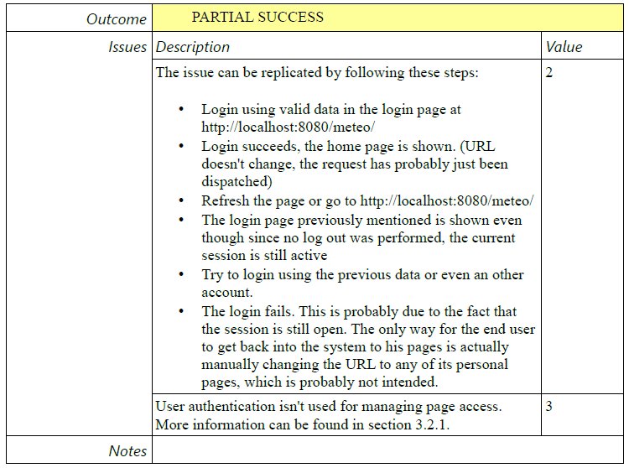
System Test Cases - Login

Slide 75
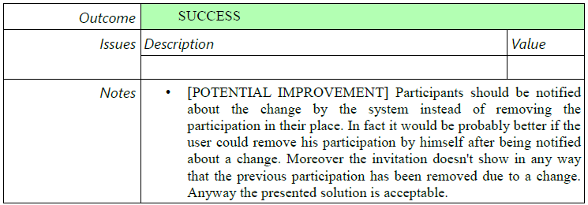
System Test Cases – Update Event
An other extract. As the previous one we will explain later the mentioned issue. In this case, updating an event causes the participants to lose their participation. Since this is probably intended, we classified the potential issue as a note.

Slide 76
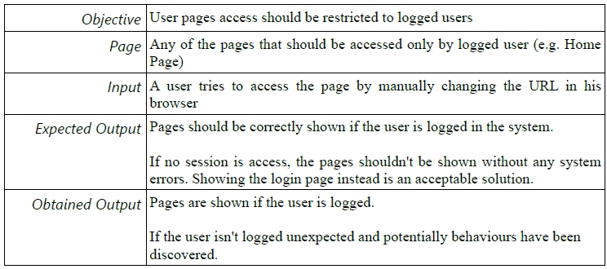
Additional System Test Cases – Page Access
To complete the testing process, we decided to integrate the proposed test cases with an additional test.

Slide 77
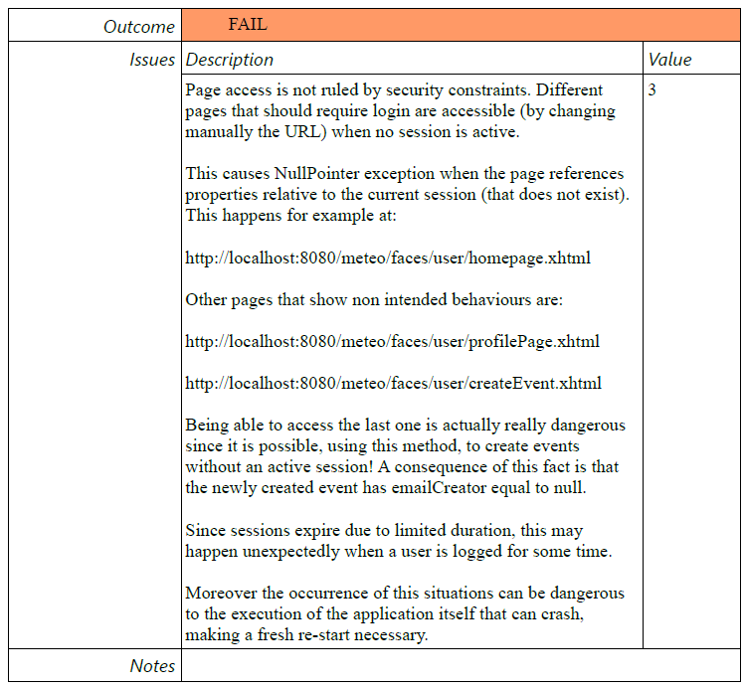
Additional System Test Cases – Page Access

Slide 78
Additional Notes – Participation Management
Participation to the events are considered though as no more than a positive answer to an invitation. This causes some behaviors that may be considered rather unpleasant for the end user:
At the current state of the system, there's no way for a user to cancel his participation to an event
On event update all current participations are removed
There’s no way to participate to an event without an invitation, even if public

Slide 79
Additional Notes – Page Navigation URLs
There is no way to get a link to the page of an event or of a user on the system, since the pages dedicated to showing these contents don't use the URLs to identify the resource requested by the system. While this doesn't represent an obstacle to the system in providing its services to the users there are also some negative consequences.
It is not possible for a person to send to someone else a link to an event page as a consequence.

Slide 80
Additional Notes – Event Page Access
At the current state of the system the only way for a user to access the page of an event he's not invited to is clicking on that event on the calendar of a participant that has set his calendar as public. Even then, only invited users can actually participate to the event since there is no “Participate” button.
The only protection that a private event page has is actually the absence of a link to that page visible to user non invited to the event. This by itself, could be considered a rather unsafe approach to this resource management problem.

Slide 81
Additional Notes – Event Page Access
This approach in fact has a flaw in the current state of the system, even if its occurrence is rather hidden. The steps to observe this flaw are the following:
Public event E is created
Since the event is public, it will be visible on the calendar page of the creator or a participant to the event if the owner set his calendar as public. User U, not invited to the event, uses the search functionality to get on such page, where there is a link to E, since E is public and stops here
Creator of E modifies E writing secret information in the description of the event and setting the event as private
User U which still has available a link to E, since he got to a calendar containing it when E was public. User U can then use this link and access the page of E and read all sensible information contained in its description

Slide 82
Conclusions
The set of operations performed in the system test cases fully covers the requirements extracted from the initial description.
As for the implementation, the majority of operations tested showed no highly relevant issues. There are anyway some that needs to be fixed since they can represent a danger for the execution of the system or problematic for the end user. The most important issue is probably the one regarding the fact that page access should be restricted to logged users, since it can lead to application failures.
To recap, the product answers fully the requests stated in the problem descriptions, but has some flaws that, for the most part, should be easily fixable. Moreover, the product offers functionalities that ease its usage. An example is the contact list, that allows suggestions for the users to invite to an event.

Slide 83
Acceptance Testing On Our Implementation

Slide 84
Acceptance Testing On Our Implementation
In this section we will answer some of the issues tracked in the Acceptance Testing document by Francesco Lattari and Alessandro Rimoldi, in which they analysed our production. Their repository can be found at:
https://code.google.com/p/meteocal-lattari-rimoldi/
Their evaluation of the System Test Cases defined by us confirms our results for the major part. In this section we will only go over the issues highlighted by them.

Slide 85
Acceptance Testing On Our Implementation - Login
About TC2 – Login:
"However if a user, once logged, manually inserts the address of the Index page, he can perform again the login, even if he’s already logged. This must be avoided."
This isn’t really an issue, and it doesn’t go against our specification. It is possible anyways to change this really easily by performing a check on page request, to see whether the user is already logged. If this is the case the user can be redirected to Home Calendar. As mentioned, this isn’t an issue, but can anyways be fixed in no more than 5 lines of code.

Slide 86
Acceptance Testing On Our Implementation - Invitation
About TC15 – Join/Decline Invitation:
"If the user accepts the invitation, the invitation still be visible on his invitations list and the “accept” and “reject” buttons are still available. So a user can accept the invitation continuously even if the system won’t do anything about that. The worst thing is that a user can first accept and then reject the invitation.“
This isn’t an issue. In fact, our specifications and our test cases clearly underline this behavior, coherent with the initial problem description. We assume that the testing group didn’t read this, and made wrong assumptions on the expected outcome. Anyway to obtain the result requested by the testing team, we would have to modify just one line of code.

Slide 87
Acceptance Testing On Our Implementation - Calendar
About TC18 – Visualize A Generic User Calendar:
“If the calendar privacy is set to “visible” and an event is set to private, the user can view that the request user is busy, but clicking on the event will redirect to the error page.”
This is a minor issue. The most expectable behavior on click for the end user is probably seeing nothing to happen, or obtain a dialog that explicitly tells that the event is private. Either way this could be done really easily by changing less than 10 lines of code.

